Slide 1
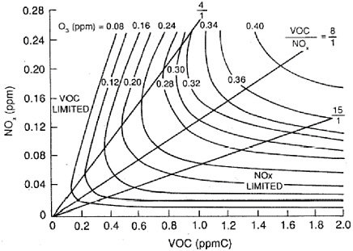
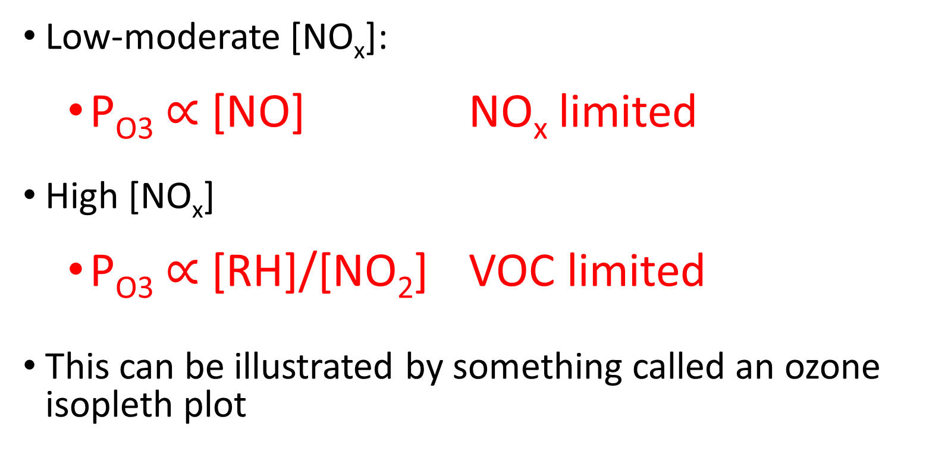
Air Pollution Chemistry
Transition regime
https://giovanni.gsfc.nasa.gov/giovanni/

Slide 2
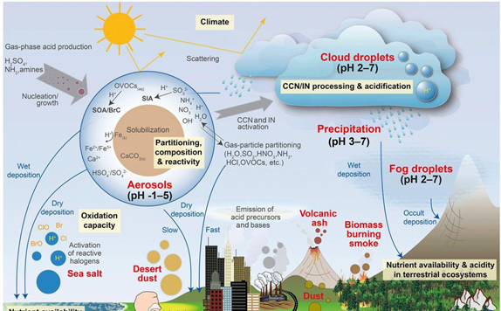
Aqueous Phase Atmospheric Chemistry
ATM 505
Spring 2022
Jie Zhang Lecture 3

Slide 3
Why consider this?
Many trace gases, including CO₂, SO₂, H₂O₂, HCHO and many others are soluble and will partially partition into the aqueous phase if there is liquid water
In terms of climate this is important in ocean acidification
Uptake of gases and reactions in the aqueous phase is also important to acid rain
Aqueous reactions also play a role in formation of Secondary Organic Aerosols (SOA)
And so on …

Slide 4

Liquid Water in the Atmosphere
The liquid water content of air is abbreviated by LWC, or more simply L, and is variously defined as
L’ = g(liquid water)/m³(air)
Since liquid water very conveniently has a mass density of very nearly 1 g/cm³, we can also write this as a volume to volume ratio
L = cm³(liquid water)/m³(air)
Numerically L’ = L (and the g/m³ and cm³/m³ forms are used interchangeably)
The LWC is a way to convert any aqueous concentration to a mixing ratio value that refers to the volume of air –
L*10⁻⁶ = (liters liquid)/(liters air) = w_{L}(mixing ratio)

Slide 5
Liquid Water Content of Air
Some typical values for L’:
  Clouds: range from
  0.05 to 3 g(water)/m³
  most often 0.1 to 0.3 g(water)/m³
  Fogs: range from 0.02 to 0.5 g(water)/m³
If using the dimensionless volume mixing ratio units:
  Clouds: mostly w_{L} from 1-3 x 10⁻⁷
  Fogs: w_{L} from 0.2 – 5 x 10⁻⁷

Slide 6
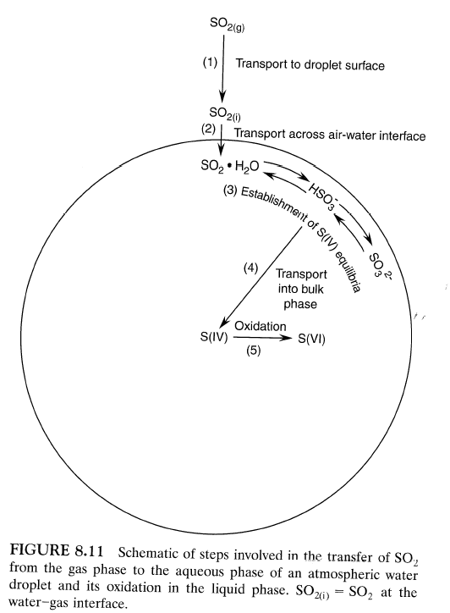
Processes involved for a reactive trace gas to undergo an aqueous oxidation reaction
Transport (diffusion) of gas to liquid surface.
Transfer of gas across the air-liquid interface. (gas-liquid equilibrium)
Formation of the aqueous phase equilibria of the dissolved species (if applicable).
Transport (diffusion) of the dissolved species into the bulk aqueous phase.
Chemical reactions in the droplet.

Slide 7
Two kinds of processes:
  Chemistry related processes such as solubility, chemical equilibria, and chemical reactions
  Mass transfer processes
For this lecture, we will consider the solubility, equilibrium, and reaction processes. The mass transfer processes will not be covered here.

Slide 8
Henry’s Law
Henry’s Law describes the equilibrium absorption of a gas into a liquid (its solubility):
A(g) + H₂O(ℓ) ⇌ A•H₂O
or A(g) ⇌ A(aq)
This is an equilibrium reaction (forward and backward reactions) and we can define an equilibrium constant, in this case called a Henry’s Law coefficient: H_{A}.
The aqueous concentration (A•H₂O or A(aq)) is usually expressed in moles/liter or M; and A(g) in atmospheres (partial pressure), so
H_{A} = [A(aq)]/p_{A} or [A•H₂O]/p_{A}; units M atm⁻¹

Slide 9
Aside on equilibrium reactions
Equilibrium reactions are “independent” of time and describe conditions at t = ∞.
We use upper case K (or sometimes for Henry’s Law upper case H) for equilibrium constants.
Units for aqueous equilibrium constants are M^{n}, or in the case of Henry’s Law, M atm⁻¹
This is in contrast to gas reaction rate constants, where we use lower case k, and units include s⁻¹ (or time⁻¹)
For the general equilibrium reaction A ⇌ B + C ;
  K = (product of product species concentrations)/
  (product of reactant species concentrations)
  or K = [B][C]/[A]

Slide 10
Henry’s Law is often written
[A(aq)] = H_{A}p_{A}
    Product conc. reactant concentration
Henry’s Law describes only the physical solubility of the gas and not any chemical changes that may occur after dissolution.
(For gases that hydrolyze and dissociate, we will later define an effective Henry’s Law coefficient H*, which takes the additional dissociated species [i.e. chemical changes] into account.)
Examples of Henry’s Law coefficients:

Slide 11
QUITE
RELATIVELY
SLIGHTLY SOLUBLE
This table from Seinfeld and Pandis
MODERATELY SOLUBLE
VERY SOLUBLE

Slide 12
Gas/Aqueous-Phase Distribution Factor
Any gaseous species with a non-zero Henry’s Law coefficient will partition between gas and aqueous phases when there is liquid water present (cloud or fog – even “wet” aerosol or haze particles).
A useful solubility benchmark for atmospheric applications is the distribution of a soluble species between gas and aqueous phases in a typical cloud (i.e., an environment with measurable liquid water). If the species resides mainly in the gas phase, it is considered somewhere between insoluble and slightly soluble. If it resides almost exclusively in the aqueous phase, it is considered very soluble. In between, species are considered moderately soluble.

Slide 13
Distribution Factor (cont.)
Notes:
Think moles! (Ideal gas law: n/V = air conc. = p/RT)
R = 0.08205 atm L mol⁻¹ K⁻¹
L = LWC in g m⁻³ or cm³ m⁻³
p_{A}H_{A} = moles A per liter solution
And 10⁻⁶ L = (liters of solution)/(liters of air)
Notes:
Cm3/m3 x (1 li soln/1000 cm3) x (1 m3/1000li air)

Slide 14
Distribution Fraction Expressions
GAS: X_{g}^{A} = 1/(1+f_{A}) ‒ gas fraction
AQUEOUS: X_{aq}^{A} = f_{A}/(1+f_{A}) – liquid fraction
The next slide shows X_{aq} as a function of L and H_{A}:
  If H_{A} < 400 M atm⁻¹, almost always <1% dissolved – relatively insoluble
  1000 < H_{A} < 100,000 M atm⁻¹, moderately soluble
  If H_{A} > 500,000 M atm⁻¹, very soluble
Even relatively insoluble and moderately soluble gases, if they are reactive in aqueous forms (or dissociate), can have aqueous chemistry that is important (i.e., SO₂ and O₃).

Slide 15
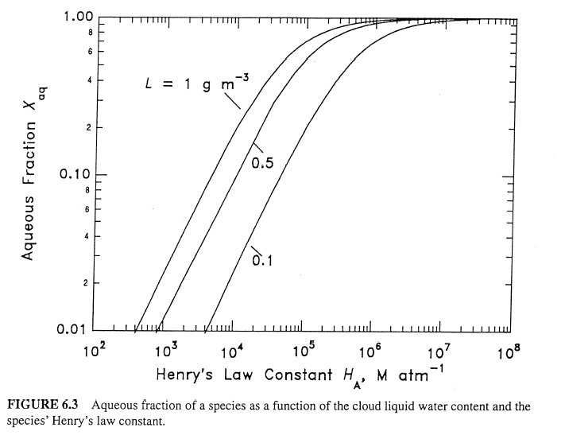

Slide 16
Aqueous Phase Chemical Equilibria
Upon dissolution into water many polar species dissociate into ions. (Other species, particularly non-polar molecules like O₂ and hydrocarbons, do not dissociate upon dissolution.) Many dissociating species first hydrolyze (add water) and then dissociate. Hydrolysis and dissociation reactions are reversible reactions that are described by equilibrium relations.
pH = -log₁₀[H⁺]

Slide 17
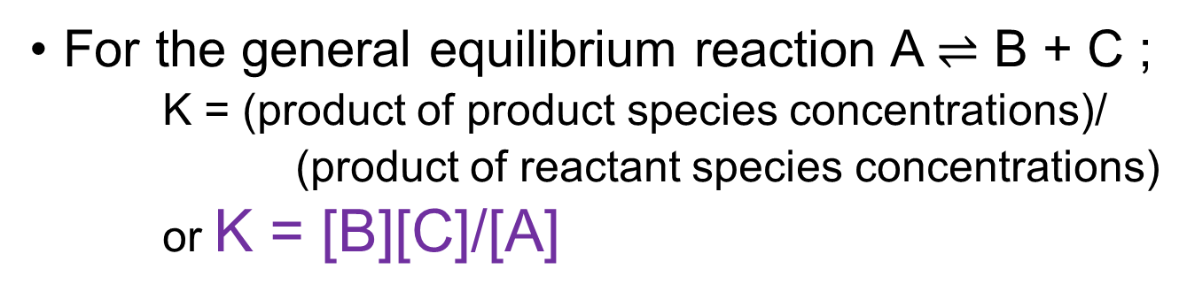
Hydrolysis and Ionization in the CO₂ – Water System
H₂O ⇌ H⁺ + OH⁻
CO₂(g) + H₂O ⇌ CO₂•H₂O
CO₂•H₂O ⇌ H⁺ + HCO₃⁻
HCO₃⁻ ⇌ H⁺ + CO₃²⁻
Henry’s law equilibrium
First dissociation
Second dissociation
Set up equilibrium expressions for each of the reactions – express each new variable in terms of K’s, P(CO₂), and [H⁺]
Note:
CO₂•H₂O is another way to write CO₂(aq)

Slide 18
CO₂/H₂O System - pH
Since H_{CO2} is small (0.034 at 298 K), p_{CO2} changes very little and can be considered constant (one can calculate f_{A} to be sure!).
From the Conservation of Charge Equation:
[H⁺] = [OH⁻] + [HCO₃⁻] + 2 [CO₃²⁻]
Substitute for each species in terms of [H⁺], and solve for [H⁺].
Algebra from equations on previous slide.
This is a cubic equation in standard form: x³ + ax + b = 0
It can be solved analytically or by iteration.

Slide 19
Units are M²
For K_{W} the constant value of [H₂O] (55.5 M) is “folded in” to the constant, which is why it has different units.

Slide 20
pH of Rainwater due to CO₂
What is the pH of rainwater at 298ºK in the presence of 400 ppm CO₂ assuming no other chemical species are present?
[H⁺]³ - (1.0x10⁻¹⁴ M² + 4.3x10⁻⁷ M x 3.4x10⁻² M atm⁻¹ x 400x10⁻⁶ atm)[H⁺] - 2(4.7x10⁻¹¹ M x 4.3x10⁻⁷ M x 3.4x10⁻² M atm⁻¹ x 400x10⁻⁶ atm) = 0
[H⁺]³ - (5.86x10⁻¹² M²) [H⁺] - 5.50x10⁻²² M³ = 0
Make (and later test) the assumption that
(5.86x10⁻¹² M²) [H⁺] >>> 5.50x10⁻²² M³
Then [H⁺]² = 5.86x10⁻¹² M²; [H⁺] = 2.42x10⁻⁶ M
pH = -log₁₀(2.42x10⁻⁶) = 5.62 (weakly acidic)
Check assumption: 1.42x10⁻¹⁷ >>> 5.50x10⁻²² ? YES! Assumption okay.
Blue equilibrium constants from Slide 18,
Purple Henry’s Law coefficients from Slide 10

Slide 21
Hydrolysis and Dissociation
CO₂ is not considered a “reactive” gas or specie from the point of view of atmospheric chemistry
However, the example of its hydrolysis and dissociation reactions has importance in familiar concepts like rainwater pH and ocean acidification
SO₂ is a pollutant gas (nearly all its emissions are anthropogenic) that behaves similarly to CO₂ upon absorption into atmospheric liquid water
SO₂ is reactive in this liquid water and is further oxidized to sulfuric acid – a major component of acid rain

Slide 22
SO₂ – Water Equilibrium
H₂O ⇌ H⁺ + OH⁻ (K_{w})
SO₂(g) + H₂O ⇌ SO₂•H₂O (H_{SO2})
SO₂•H₂O ⇌ H⁺ + HSO₃⁻ (K_{s1})
HSO₃⁻ ⇌ H⁺ + SO₃²⁻ (K_{s2})
Set up equilibrium expressions and solve for each of the species (in terms of H⁺)

Slide 23
SO₂ – Water Equilibrium (cont.)
From the SO₂ - water equilibrium system the total dissolved sulfur in the oxidation state 4, S(IV) is :
[S(IV)](aq) = [SO₂ • H₂O] + [HSO₃⁻] + [SO₃²⁻]
substituting for each of the terms on the right hand side of the equation from their respective equilibria one can relate [S(IV)] to the partial pressure of SO₂ over the solution by
The above equation can be expressed in terms of a modified or effective Henry's law coefficient H*_{S(IV)} where
[S(IV)](aq) = H*_{S(IV)} P_{SO2}
and

Slide 24
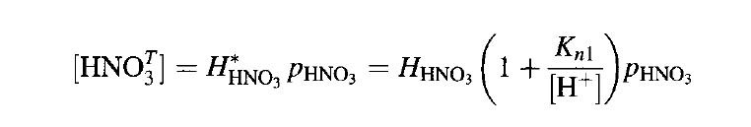
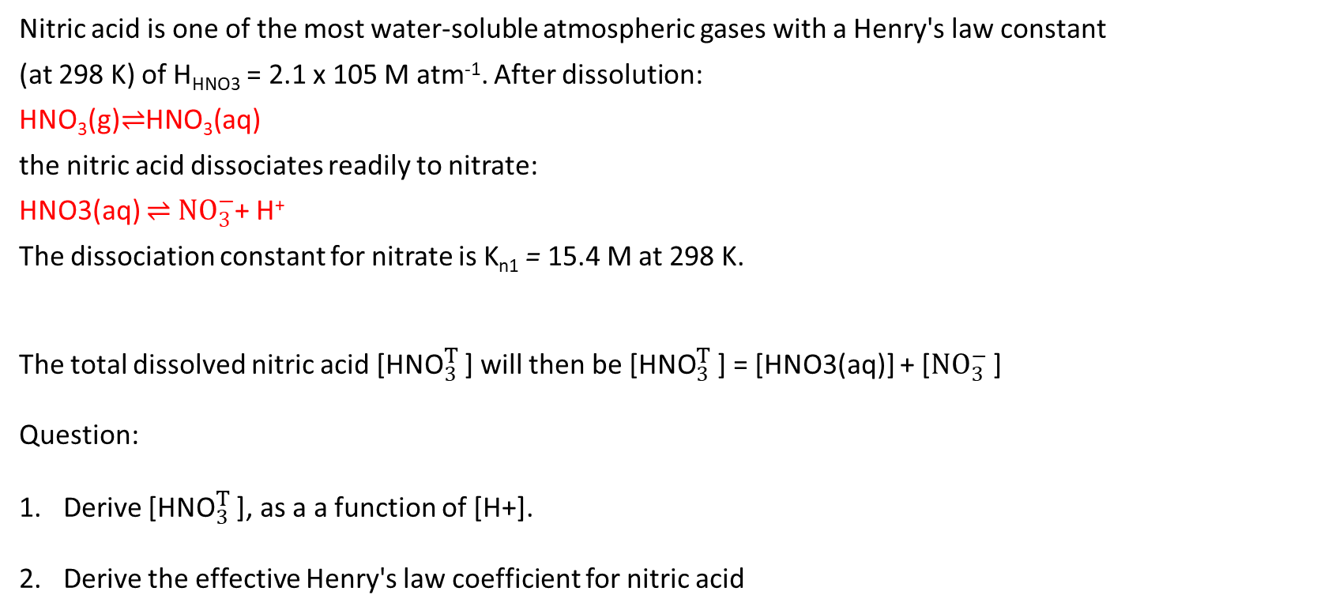

Effective Henry's law coefficient practice
Nitric acid is one of the most water-soluble atmospheric gases with a Henry's law constant
(at 298 K) of H_{HNO3} = 2.1 x 105 M atm⁻¹. After dissolution:
HNO₃(g)⇌HNO₃(aq)
the nitric acid dissociates readily to nitrate:
HNO3(aq) ⇌ ${NO}_{3}^{−}$+ H⁺
The dissociation constant for nitrate is K_{n1} = 15.4 M at 298 K.
The total dissolved nitric acid [${\text{HNO}}_{3}^{T}$ ] will then be [${\text{HNO}}_{3}^{T}$ ] = [HNO3(aq)] + [${NO}_{3}^{−}$ ]
Question:
Derive [${\text{HNO}}_{3}^{T}$ ], as a a function of [H+].
Derive the effective Henry's law coefficient for nitric acid
${\text{H}}_{HNO3}^{∗}$

Slide 25
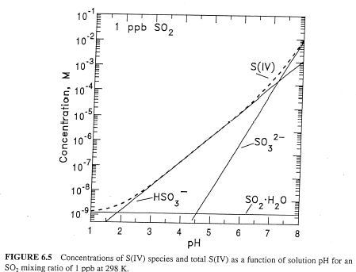
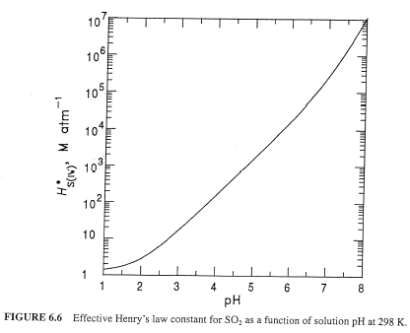
SO₂ is an “acid gas”, so it becomes much more soluble as the water becomes less acidic, i.e., as pH increases

Slide 26
Dissolved S(IV) (cont.)
Note that the effective Henry’s Law constant for S(IV) increases by almost 7 orders of magnitude as the pH increases from 1 to 8.
Also note that [SO₂•H₂O] does not depend on pH – the increase in [S(IV)] is due to [HSO₃⁻] and [SO₃²⁻]. (Physical solubility alone vs. hydrolysis)
Dissolved [S(IV)](aq) depends on T, pH, and p_{SO2} – Figure on previous slide.
One can write expressions for the aqueous mole fractions of the 3 dissolved S(IV) species – plotted in Figure on previous slide.
Generally speaking:
  pH < 2 (very acidic) ⇒ physical solubility dominates
  3 < pH < 6 (most common) ⇒ HSO₃⁻ dominates
  pH > 7 (basic - less common) ⇒ SO₃²⁻ dominates

Slide 27
Processes involved for an atmospheric trace gas to undergo an aqueous oxidation reaction (revisited)
Transport (diffusion) of gas to liquid surface.
Transfer of gas across the air-liquid interface. (gas-liquid equilibrium)
Formation of the aqueous phase equilibria of the dissolved species (if applicable).
Transport (diffusion) of the dissolved species into the bulk aqueous phase.
Chemical reactions in the droplet.

Slide 28
Aqueous Phase Reaction Rates
A(aq) + S(IV)(aq) → Products (k)
Aqueous Rate = R_{A} = k [A(aq)] [S(IV)]
This example is a second order reaction.
UNITS:
[A(aq)], [S(IV)] – M (moles/liter)
k - M⁻¹s⁻¹ (units for 2nd order rate constant)
R_{A} - M s⁻¹ (i.e. moles of S(IV) oxidized per liter of solution per second)
It makes more sense for us to consider the rate per liter of air volume, not liquid volume; so convert this expression to moles per liter of air per second by multiplying by 10⁻⁶L or w_{L}:

Slide 29
Ozone – S(IV) Reaction
Ozone reacts with all three dissolved S(IV) species, but with rather different rates.
S(IV) + O₃ → S(VI) + O₂ (not balanced)
The reaction rate is the sum of three terms
R_{O3} = -d[S(IV)]/dt
= (k₀[SO₂•H₂O] + k₁[HSO₃⁻] +k₂[SO₃²⁻])[O₃]
k₀ = 2.4±1.1x10⁴ M⁻¹s⁻¹;
k₁ = 3.7±0.7x10⁵ M⁻¹s⁻¹;
k₂ = 1.5±0.6x10⁹ M⁻¹s⁻¹;

Slide 30
Ozone – S(IV) Reaction
The complex pH dependence of this combined rate coefficient is shown on the next slide.
The reaction is self-limiting – as it proceeds the droplet (solution) becomes more acidic, which slows down the reaction.
Since O₃ is ubiquitous, the O₃- S(IV) reaction will always contribute to S(IV) oxidation and cloud water acidification. (Even if sometimes the contribution is relatively small.)

Slide 31
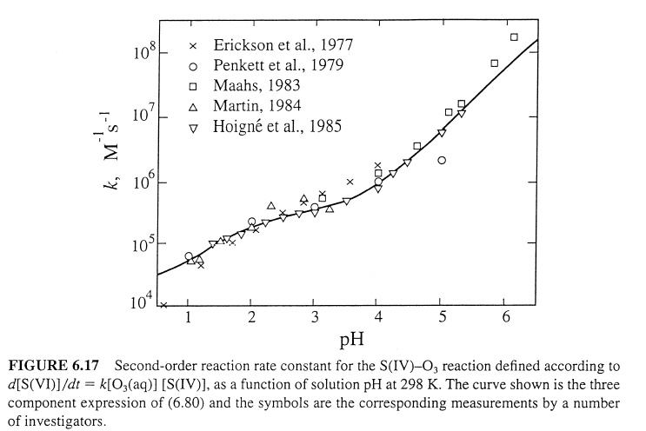

Slide 32
H₂O₂ – S(IV) Reaction
H₂O₂ is perhaps the single most effective oxidant of S(IV) in clouds and fogs. It is very soluble (check out Henry’s Law coefficient on slide 9).
Its reaction with S(IV) is so rapid that H₂O₂ and S(IV) rarely coexist in cloud or fog droplets, or in air containing clouds or fog. (That is, either H₂O₂ or SO₂ is effectively depleted by the reaction.)

Slide 33
Summary of H₂O₂- S(IV) Reaction
k = 7.5±1.16x10⁷ M⁻²s⁻¹ at 298 K
E_{A}/R = - 4430 K (reaction T-dependence)
K = 13 M⁻¹ at 298 K
Figure on the next slide shows rate coefficient measurements for this reaction.
The pH dependence of the 2nd order rate coefficient [i.e., k∗[H⁺] from above] (Fig. 6.19 ) and of the expression for [HSO₃⁻] (=H_{SO2}K_{s1}p_{SO2}/[H⁺]), nearly cancel each other out, so the rate of reaction is practically independent of pH for pH values greater than 2 – see Figure 6.18. (This is very different than O₃!)

Slide 34
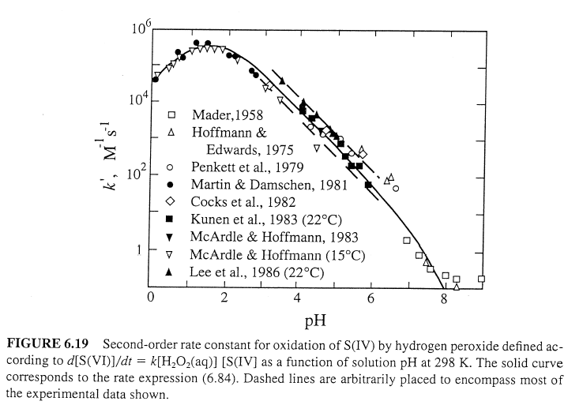

Slide 35
Aqueous Phase Organic Chemistry
SO₂ and sulfate have dropped dramatically (more than 80%) since the mid-1980s.
Nitrate has also decreased (but not as much).
On the other hand, there has not been a similar trend in organic compounds.
The result is that inorganic chemistry of sulfate, nitrate, and ammonium, while still important, does not dominate aqueous atmospheric chemistry like it used to.
Simple organic acids like formic, acetic, and oxalic acid are important in solution.
Cloud and rainwater acidity now show significant contributions from organic acids. (Which is good!)

Slide 36
Secondary Organic Aerosol (SOA) Formation
(a preview of the next lecture)
Aqueous phase organic chemistry also contributes to organic aerosol formation.
Organic gases that are soluble in cloud water often undergo further oxidation to produce highly oxidized species, which are less volatile.
Less volatile compounds are those that partition more readily to the condensed phase.
If the droplet evaporates, the less volatile organic products remain as particles and contribute to the atmospheric SOA mass.

Slide 37
